Slide 1


A RETROSPECTIVE STUDY ON CLINICAL FEATURES AND MANAGEMENT FOR COVID-19 PATIENTS
ACADEMIC GUIDE: Dr .SRAVANI
Doctor Of Pharmacy, Asst.Professor,
Malla Reddy College of Pharmacy, Maisammaguda ,
District,Secunderabad -500055.
PRESENTED BY:
CHOLAPALLI SRINITHA REDDY (256216882005) KURUKU NEILNANDAN (256216882013)
NATTA MANISHA (256216882019)
KOUSAR BEGUM (256219883004)

Slide 2
CONTENTS
INTRODUCTION
NEED OF THE STUDY
AIM AND OBJECTIVES
LITERATURE REVIEW
MATERIALS AND METHODOLOGY
STUDY PROCEDURE
RESULTS
DISCUSSION
CONCLUSION
REFERENCES

Slide 3
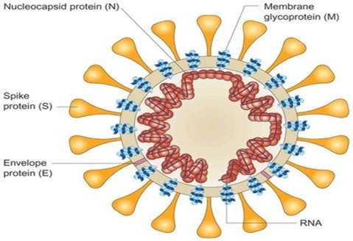
INTRODUCTION:
A corona virus is a kind of common virus that causes an infection in nose, sinuses, or upper throat. COVID-19 is a disease caused by SARS- which can trigger respiratory tract infection.

Slide 4
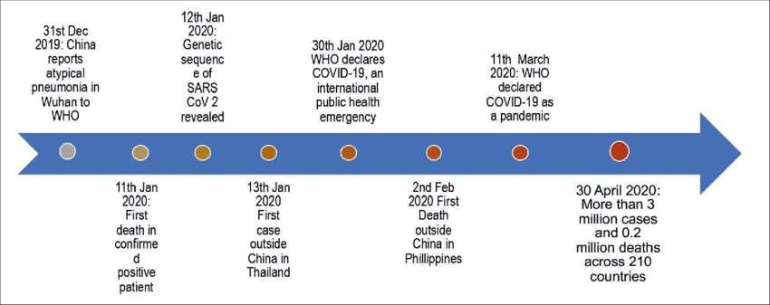
EPIDEMOLOGY
In December 2019, more than 90% of reported corona virus disease cases . However, by March 2020, the highest prevalence of COVID-19 was recorded in Italy, United States, Spain, France, Iran and Germany.

Slide 5
ETIOLOGY:
Complete viral genome analysis reveals that the virus shares 88% sequence identity with severe acute respiratory syndromes (SARS).
Corona virus is an enveloped and single-stranded ribonucleic acid named for its solar corona like appearance due to 9–12 nm-long surface spikes .
There are four major structural proteins encoded by the corona viral genome on the envelope, one of which is the spike (S) protein that binds to the angiotensin-converting enzyme 2 (ACE2) receptor and mediates subsequent fusion between the envelope and host cell membranes to aid viral entry into the host cell.

Slide 6
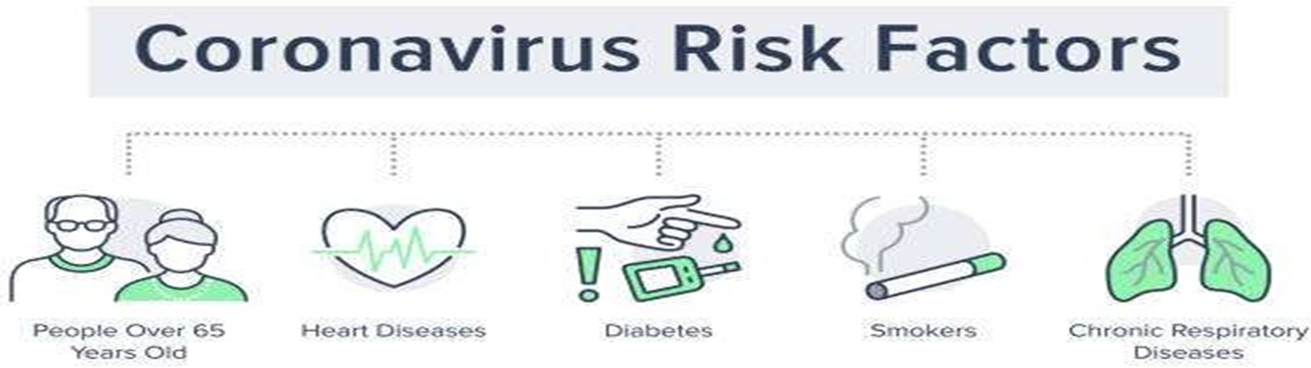
RISK FACTORS &COMPLICATIONS:
Acute Respiratory Distress Syndrome (ARDS)
Irregular Heart Rate (Arrhythmia)
Cardiogenic Shock
Kidney Injury Or Kidney Failure (Including Needing Dialysis)
Severe Muscle Pain
Fatigue
Heart Attack
Multisystem Inflammatory Syndrome In Children (MIS-C); This Is Also Known As Pediatric Multisystem Inflammatory Syndrome (PMIS)
A Weakened Immune System From A Solid Organ Transplant
Pregnancy
Sickle Cell Disease
Type 2 Diabetes
Cancer

Slide 7
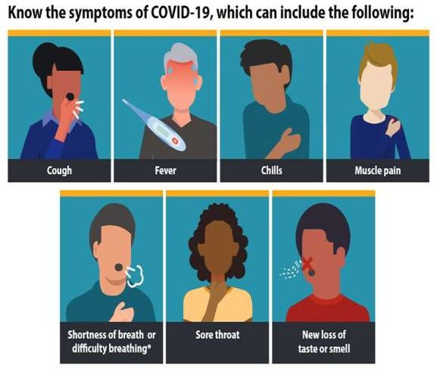
SIGNS AND SYMPTOMS OF COVID-19:
The main symptoms include:
Fever
Dry cough
Shortness of breath
Trouble breathing
Fatigue
Chills,
Body aches
Headache
Sore throat
Congestion/runny nose
Loss of smell or taste
Nausea
Diarrhea

Slide 8
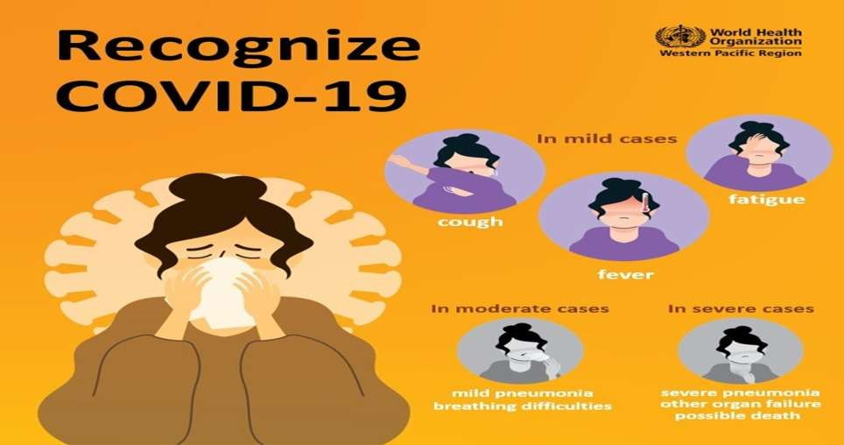

Slide 9
CORONA VIRUS TREATMENT:
People who get a mild case need care to ease their symptoms, like rest, fluids, and fever control.
Take over-the-counter medicine for a sore throat, body aches, and fever. But don't give aspirin to children or teens younger than 19.
Generally Most Prescribed Medicine.
Antibiotics
Antiviral
Steroids
Multivitamins
Anticoagulants

Slide 10

CORONA VIRUS PREVENTION
Take These Steps:
Wear a mask
Wash Hands Often With Soap And Water Or Clean Them With An Alcohol-based Sanitizer.
Practice Social Distancing.
Don’t Touch Face.
Clean And Disinfect the objects and surfaces

Slide 11
NEED OF THE STUDY:
➢ The need of present study is to describe clinical features and management in covid 19 infection
➢ To quantify the changes or adjustments made to the initial therapy and to determine the appropriateness of antibiotics, antivirals, PPI’S, multivitamins, anticoagulants, steroids and other drugs using standardized quality indicators.
➢ To determine management based on clinical features, early detection and prevention of complications in covid-19 patients

Slide 12
AIM AND OBJECTIVES
AIM AND OBJECTIVES:
The aim of present study is to describe clinical features and different levels of management in covid 19 infection
OBJECTIVES:
PRIMARY OBJECTIVE: To determine management in covid 19 infection based on symptoms.
SECONDARY OBJECTIVES: Early detection and prevention of complications in covid-19 patients

Slide 13
LITERATURE REVIEW
S.NO | TITLE | AUTHOR | PUBLISHED YEAR | CONCLUSION
1. | Clinical features and risk factors for severe inpatients with COVID-19: A retrospective study in China | Juan Wang , Shuzhen Guo , Yili Zhang, Kuo Gao et al | 2020 | The potential risk factors found in our study have shown great significance to prevent COVID-19 patients from aggravating and turning to critical cases during treatment. Meanwhile, focusing on gender and age factors in groups with different severity of COVID-19, and paying more attention to specific clinical symptoms and characteristics, could improve efficacy of personalized intervention to treat COVID-19 effectively.
2. | A Retrospective Analysis of the Clinical and Epidemiological Characteristics of COVID-19 Patients in Henan Provincial People's Hospital, Zhengzhou, China | Jing Zhao, Hao Gao, Zi-Yi Feng and Qi-Jun Wu | 2020 | Significant differences in demographical and clinical characteristics were observed in patients with moderate and severe COVID-19.

Slide 14
S.NO | TITLE | AUTHOR | PUBLISHED YEAR | CONCLUSION
3. | Clinical course and risk factors for mortality of adult inpatients with COVID-19 in Wuhan, China: a retrospective cohort study | Jordan Messler | 2020 | . The longest observed duration of viral shedding in survivors was 37 days. The potential risk factors of older age, high sofa score, and d-dimer greater than 1 μg/mL could help clinicians to identify patients with poor prognosis at an early stage. Prolonged viral shedding provides the rationale for a strategy of isolation of infected patients and optimal antiviral interventions in the future.

Slide 15
MATERIALS:
The data was collected in a specially designed pro-forma for collecting patient details along with
relevant laboratory and other data. METHODOLOGY RESEARCH DESIGN:
A retrospective study
RESEARCH SUBJECTS
INCLUSION CRITERIA:
All the patients who admitted in covid ward during study period.
SAMPLE SIZE: 100 patients
STUDY PERIOD: This study will be conducted over a period of 6 months.

Slide 16
STUDY PROCEDURE:
This retrospective study conducted in Malla Reddy Hospital Medical Records Department
All the necessary and relevant data collected from the patient profiles, treatment charts, laboratory reports, progress charts and electronic medical records. It is recorded in a specially designed patient data collection form.
Collected data was properly analyzed

Slide 17
PLAN OF WORK:
SELECTION OF TOPIC
REVIEW OF LITERATURE
↓
PREPARATION OF PROTOCOL
↓
SELECTION OF PATIENTS BASED ON INCLUSION CRITERIA
↓
DEMOGRAPHICS,PRESCRIPTION DATA WILL BE COLLECTED USING DATA COLLECTION FORM
↓
RESULT ANALYSIS WILL BE DONE
↓
DISCUSSION
↓
CONCLUSION

Slide 18
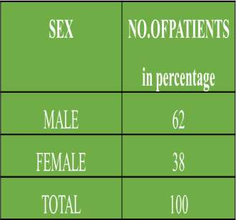
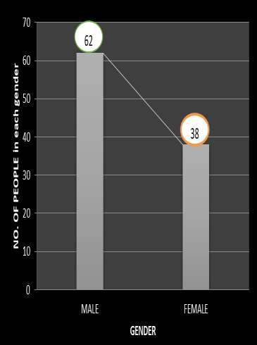
RESULTS
SEX WISE DISTRIBUTION OF PATIENTS IN COVID-19
FIG:1 Reported that male patients (62%) are more effected than female patients (38%).

Slide 19
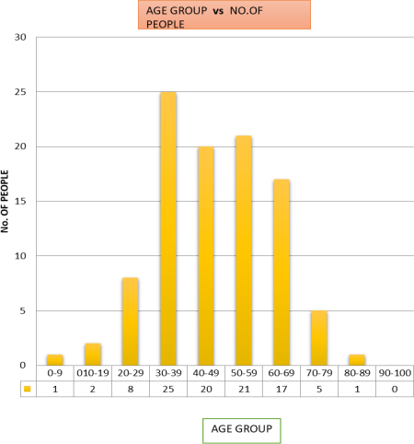
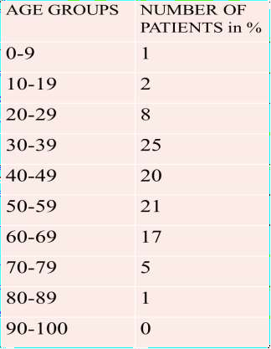
NUMBER OF PATIENTS BASED ON THEIR AGE GROUPS IN COVID-19
Fig:2 Reported that the patients with age group 30-39years are mostly effected and 0-9 & 80-89 are least effected

Slide 20
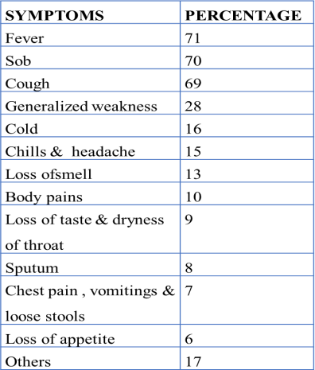
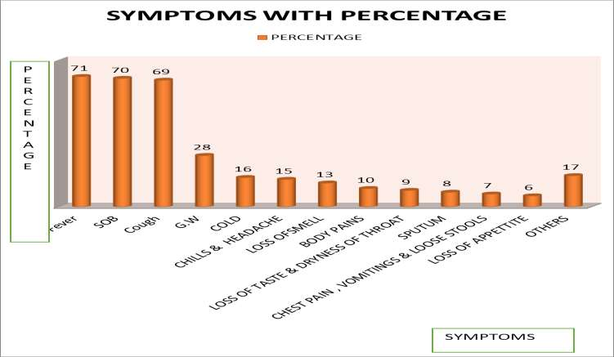
DISTRIBUTION OF PATIENTS BASED ON SYMPTOMS IN COVID-19
Fig :3; Reported that the patients shown symptoms of more percentage with fever ( 71%) & less percentage with Loss Of Appetite ( 6%)

Slide 21
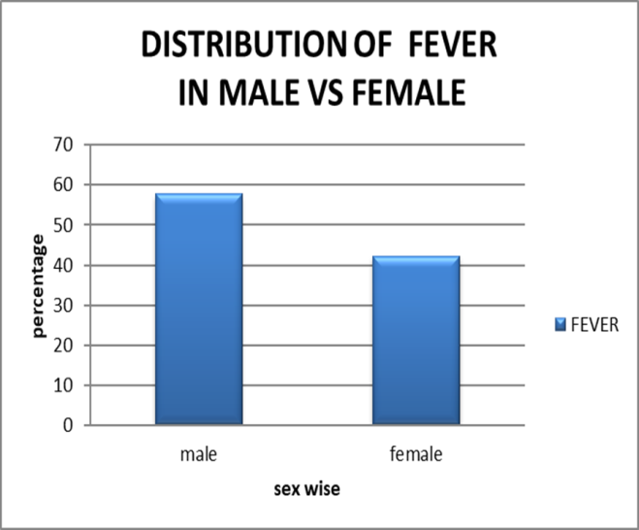
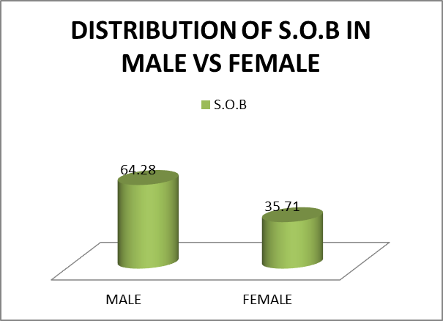
DISTRIBUTION OF FEVER IN MALE VS FEMALE
MALE | FEMALE
57.74 | 42.2
Fig :4 The above fig shows males reported with fever were 57.74% while females reported 42.2%. Which shows that male was more symptomatic than females.
DISTRIBUTION OF S.O.B IN MALE VS FEMALE
MALE | FEMALE
64.28 | 35.71
Fig :5 The above fig shows males reported with sob were 64.28% while females reported 35.71%. Which shows that male was more symptomatic than females.

Slide 22
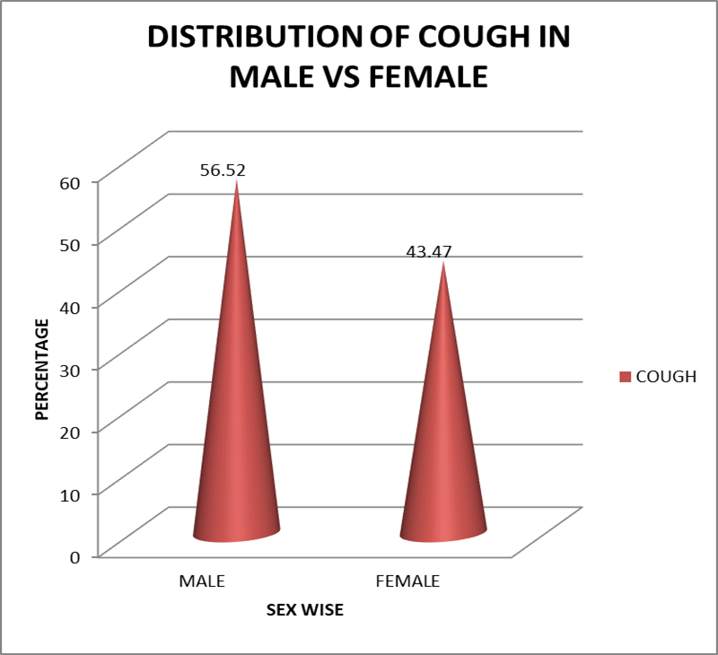
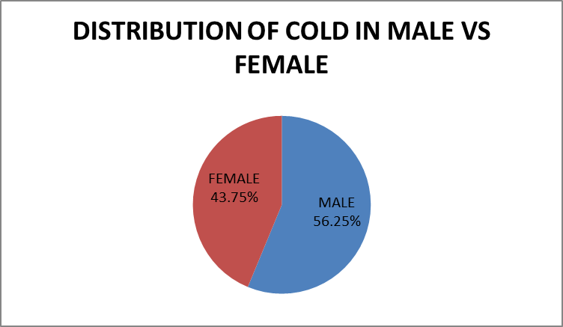
DISTRIBUTION Of DRY COUGH IN MALE VS FEMALE
MALE | FEMALE
56.52 | 43.47
Fig :6The above fig shows males reported with dry cough were 56.52% while females reported 43.47%. Which shows that male was more symptomatic than females.
DISTRIBUTION OF COLD IN MALE VS FEMALE
MALE | FEMALE
56.25 | 43.75
Fig :7 The above fig shows males reported with cold were 56.25% while females reported with 43.75%. Which shows that male was more symptomatic than females.

Slide 23
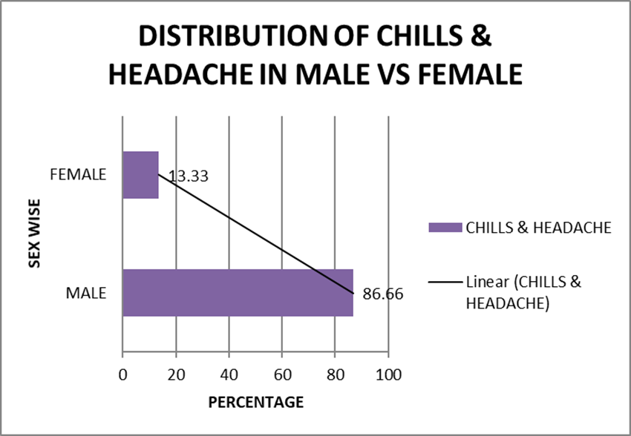
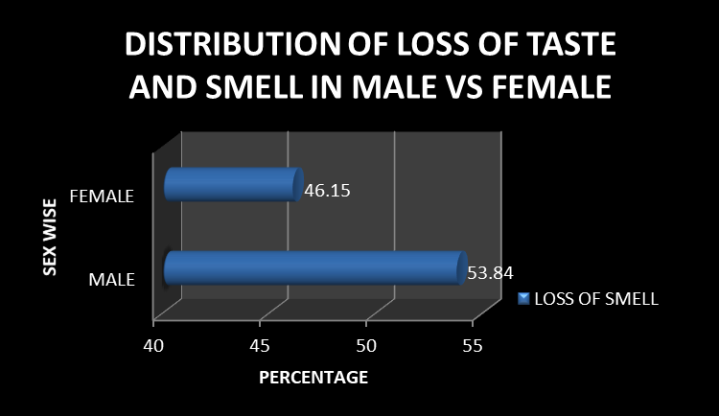
DISTRIBUTION OF CHILLS AND HEADACHE IN MALE VS FEMALE
MALE | FEMALE
86.66 | 13.33
Fig :8 The above fig shows males reported with chills and headache were 86.66% while females reported 13.33%. Which shows that male was more symptomatic than females.
DISTRIBUTION OF LOSS OF TASTE AND SMELL IN MALE VS FEMALE
MALE | FEMALE
53.84 | 46.15
Fig :9 The above fig shows males reported with loss of taste and smell were 53.84% while females reported 46.15%. Which shows that male was more symptomatic than females

Slide 24
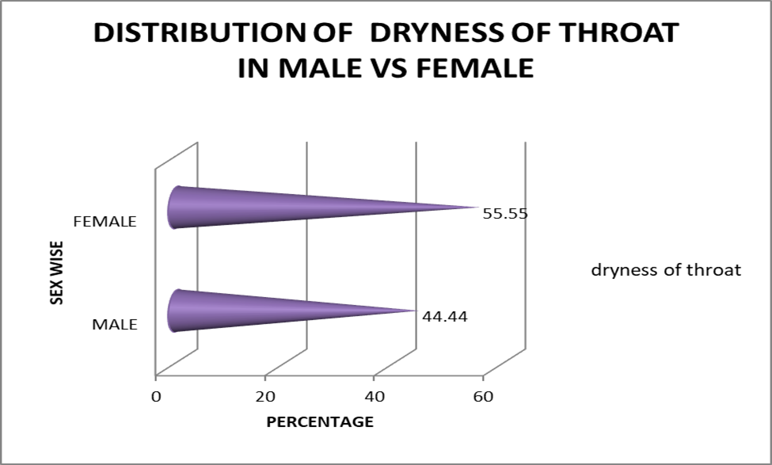
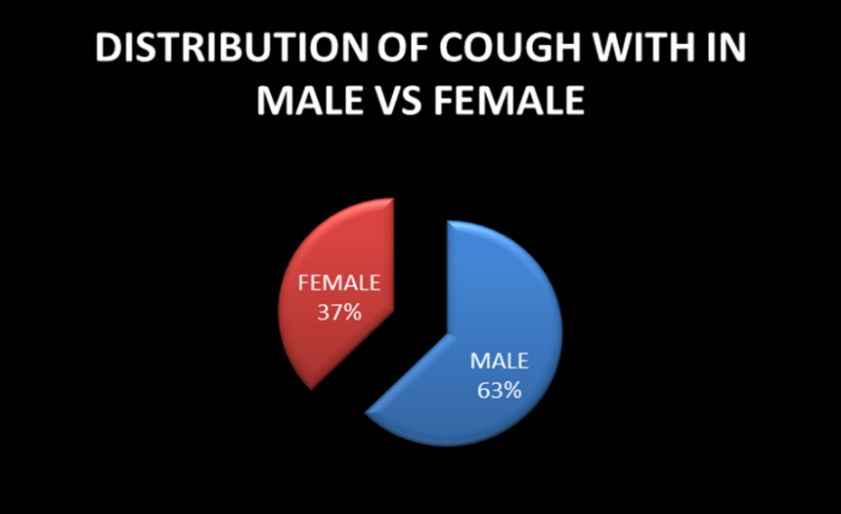
DISTRIBUTION OF DRYNESS OF THROAT IN MALE VS FEMALE
MALE | FEMALE
44.44 | 55.55
Fig :10 The above fig shows female reported with dryness of throat were 55.55% while males reported 44.44%. Which shows that female was more symptomatic than males.
DISTRIBUTION OF COUGH WITH SPUTUM IN MALE VS FEMALE
MALE | FEMALE
62.8 | 37.5
Fig :11 The above fig shows males reported with cough with sputum were 62.8 % while females reported with fever 37.5%. Which shows that male was more symptomatic than females.

Slide 25
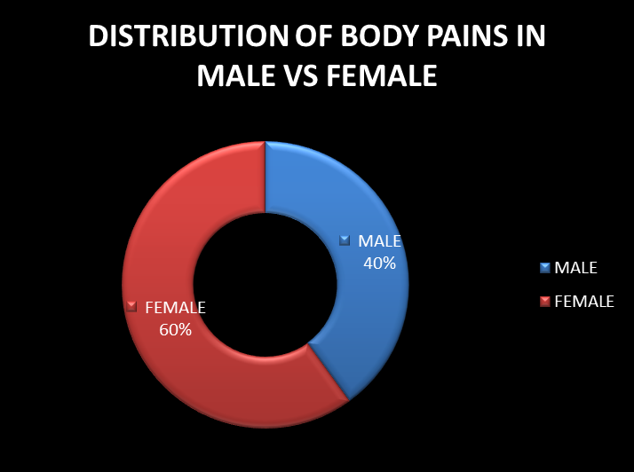
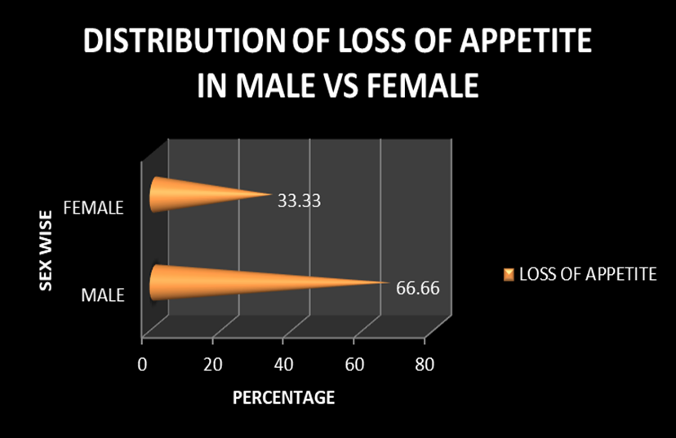
DISTRIBUTION OF BODY PAINS IN MALE VS FEMALE
MALE | FEMALE
40% | 60%
Fig :12The above fig shows females reported with body pains were 60% while males reported40%. Which shows that female was more symptomatic than males.
DISTRIBUTION OF LOSS OF APPETITE IN MALE VS FEMALE
MALE | FEMALE
66.66 | 33.33
Fig :13 The above fig shows males reported with loss of appetite were 66.66% while females reported with fever 33.33%. Which shows that male were more symptomatic than females.

Slide 26
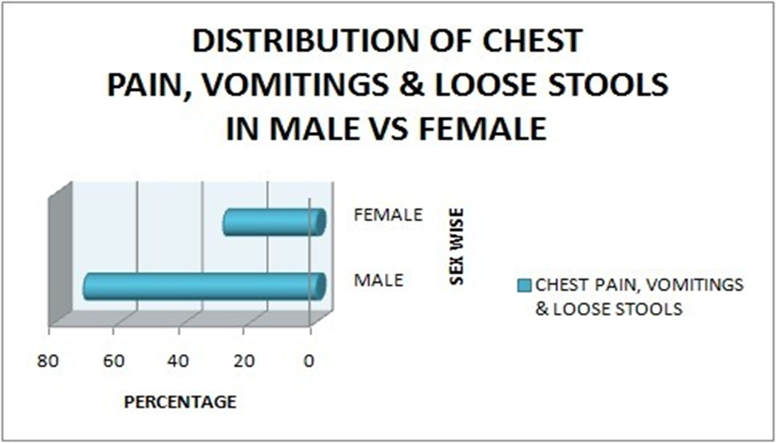
DISTRIBUTION OF CHEST PAIN, VOMITINGS& LOOSE STOOLS IN MALE VS FEMALE
MALE | FEMALE
71.42 | 28.47
Fig :14The above fig shows males reported with other symptoms were 71.42% while females reported 28.47%. Which shows that male was more symptomatic than females.

Slide 27
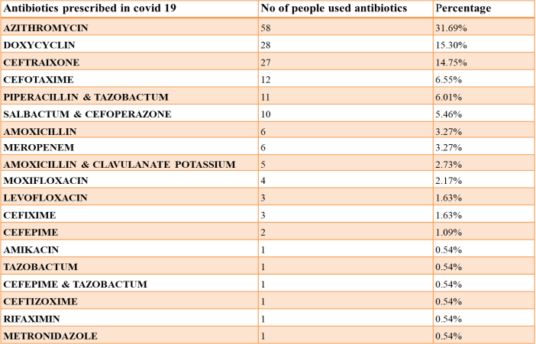
PRESCRIBING PATTERN OF ANTIBIOTICS IN COVID-19

Slide 28
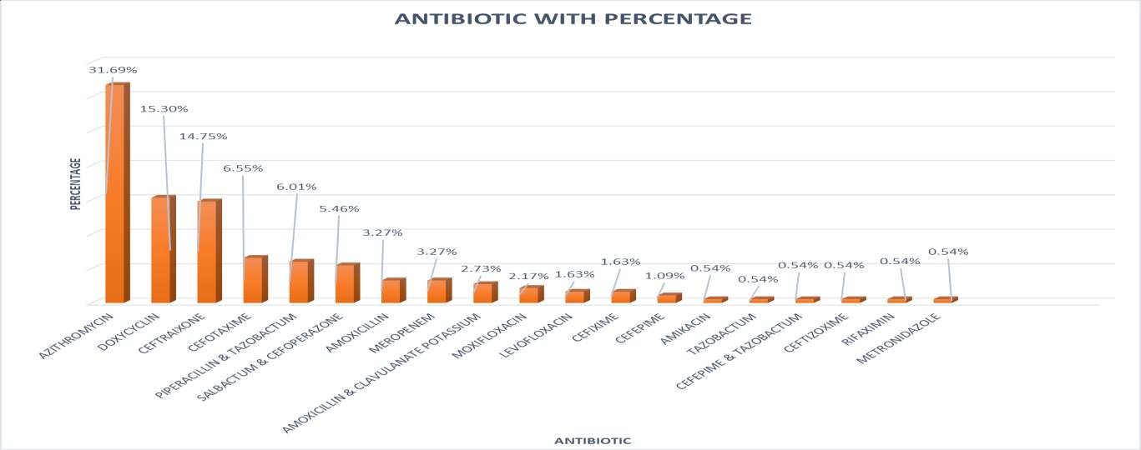
Fig. 15; the above fig shows 31.69% of patients were prescribed with azithromycin, 15.30% were prescribed with doxy, 14,75% were prescribed with ceftriaxone and least prescribed drugs were amikacin, tazobactam, metrogyl, rifaximin with 0.54%

Slide 29
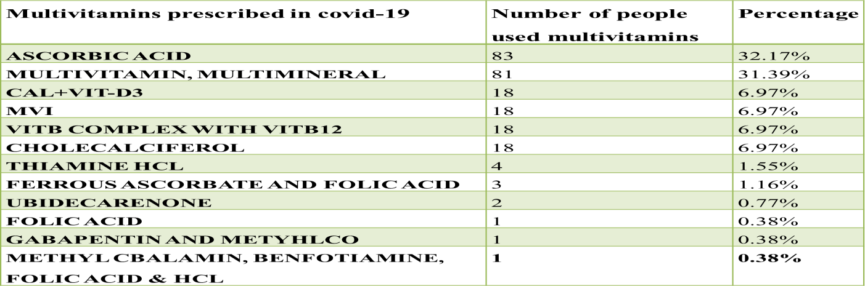
PRESCRIBING PATTERN OF MULTIVITAMINS IN COVID-19

Slide 30
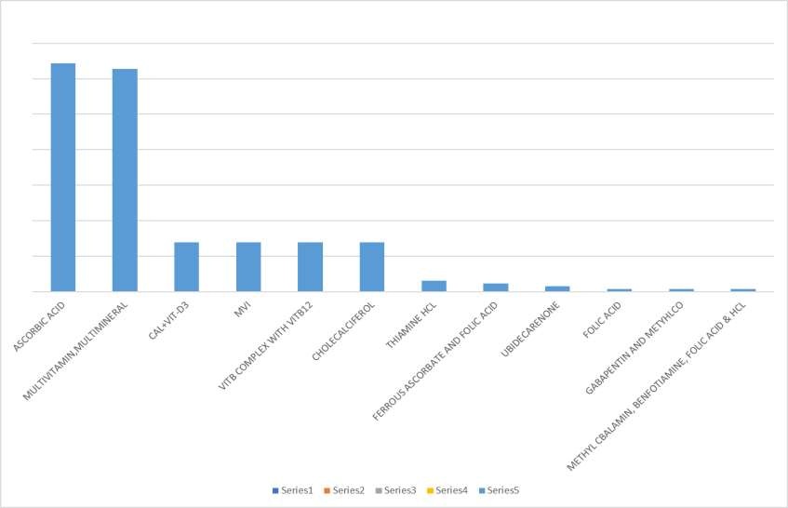
Fig :16 the above fig shows that 32.17% of patients were prescribed with ascorbic acid and 31.39% of patients were prescribed with multivitamin and multimineral which shows that ascorbic acid was most prescribed multivitamin.

Slide 31
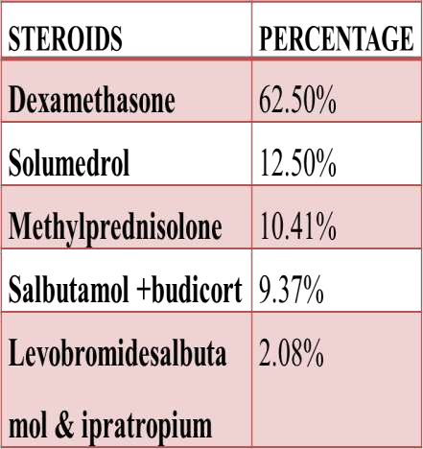
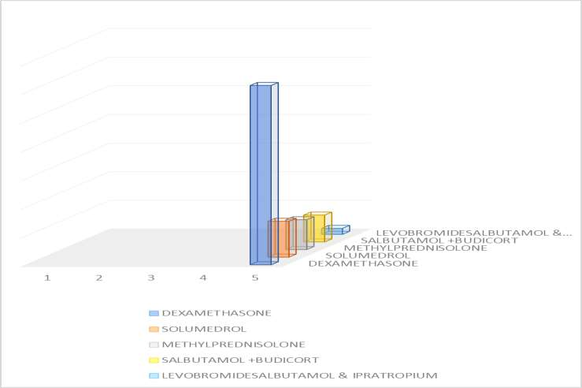
PRESCRIBING PATTERN OF STEROIDS IN COVID-19
Fig : 17 The Above Fig Shows That 62.50% Of Patients Were Prescribed With Dexamethasone, 12.50% Of Patients Were Prescribed With Solumedrol, 10.41% Of Patients Were Prescribed With Methylprednisolone, 9.37% 0f Patient Were Prescribed With Salbutamol + Budicort, 2.08% Of Patients Were Prescribed With Levobromidesalbutamol& Ipratropium.

Slide 32
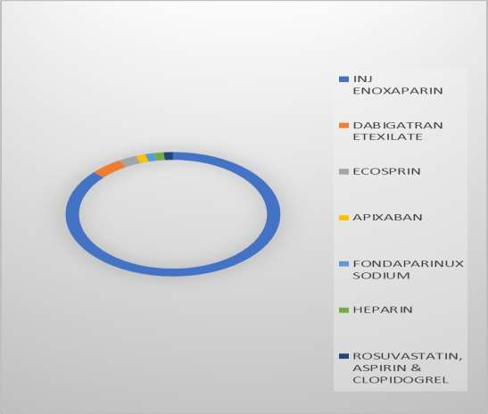
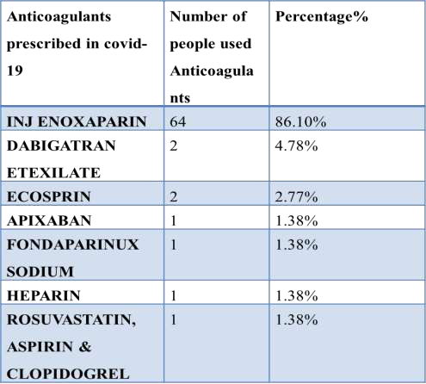
PRESCRIBING PATTERN OF ANTICOAGULANTS IN COVID-19
Fig : 18The Above Fig Shows That 86.1% Patients Were Treated With Inj Enoxaparin,4.78% Of Patients Were Treated With Dabigatran, 2,77% Of Were Treated With Ecosprin And 1.38% Of Patients Were Treated With Apixaban, Fondaparinux, Heparin, Rosuvastatin, Aspirin & Clopidogrel Which Shows That Inj Enoxaparin Is Mostly Used Anticoagulant.

Slide 33
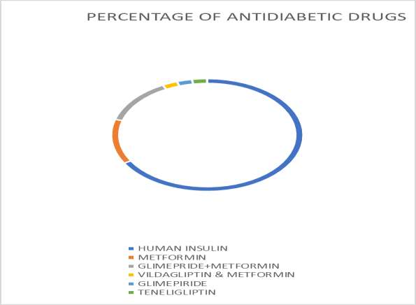
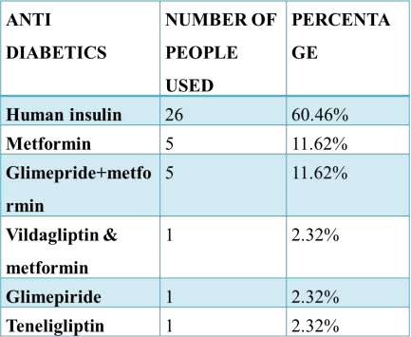
PRESCRIBING PATTERN OF ANTI DIABETICS IN COVID-19
Fig. 19 the above fig shows that 60.46% of patients were prescribed with human insulin, 11.62% of patients were prescribed with metformin, glimepiride +metformin,2.32% of patients were prescribed with vildagliptin & metformin, glimepiride, teneligliptin.

Slide 34
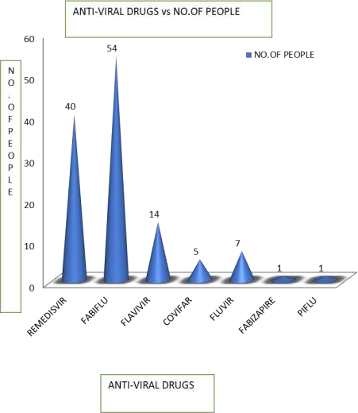
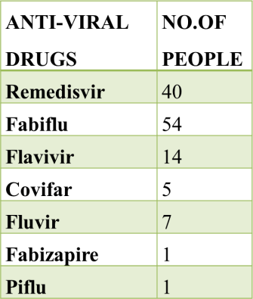
PRESCRIBING PATTERN OF ANTI- VIRAL DRUGS IN
COVID-19
Fig. 20 : Reported that the patients treated with fabiflu with more percentage like 54% and fabizapire&piflu with least percentage lie 1%

Slide 35
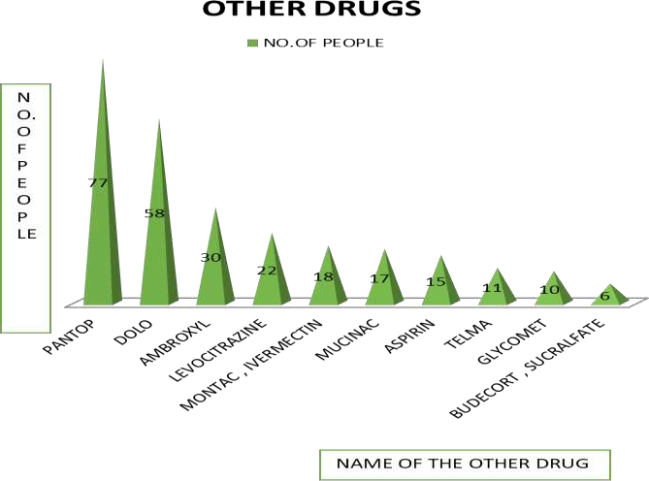
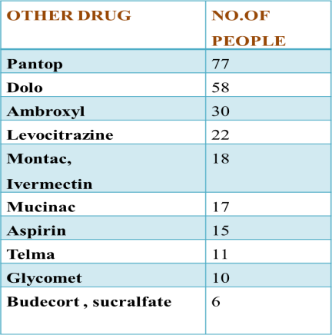
PRESCRIBING PATTERN OF OTHER DRUGS IN COVID-19
Fig.21 : Reported that the patients treated with Pantop was more percentage like 77% and least percentage with budecort& sucralfate like 6%

Slide 36
DISCUSSIONS:
In this study, we retrospectively analysed the clinical characteristics of patients with different outcomes and described the clinical course of symptoms, and treatment process during hospitalization.
Focusing on gender and age factors in groups with different severity of covid-19, and paying more attention to specific clinical symptoms and characteristics, could improve efficacy of personalized intervention to treat covid-19 efficacy
Out of all patients analysed in the study who were having covid-19, 62% of patients were male and 38% were female patients.
When the demographic profiles of the patients were done it was found that 25% of patients are of range 30-39 years and 21% of patients are of range 50-59 years. In our study it can be said that covid 19 is more common in middle age group followed by older age group.

Slide 37
CONCLUSION
Different levels of management mainly depend on clinical features and how they respond to the treatment,
from our study we concluded that Males were more symptomatic than females.
Clinical pharmacists play a major role in early detection and prevention of medication errors and thus can improve the quality of care to the patients.
We found prescribing steroids to patients increases risk of opportunistic infection so before prescribing steroids we should look for serum cortisol levels and thoroughly check for any pre-existing fungal infections which worsen prognosis of disease.
Our study concludes multisystem association of covid-19, were majority of patients presents with fever, respiratory features (like cough, sob, cold) sore throat, headache, loss of appetite etc. The reviews show 1% people were asymptomatic, this should be seen with caution as the studies are taken from hospital setting not community. In community more asymptomatic cases might be present than in hospital. Major modalities of management include antibiotic, antiviral and steroid therapy having no direct relationship between the specific treatment and the outcome. The need for further study for specific treatment and timely evidence-based updates on existing guidelines is required.

Slide 38
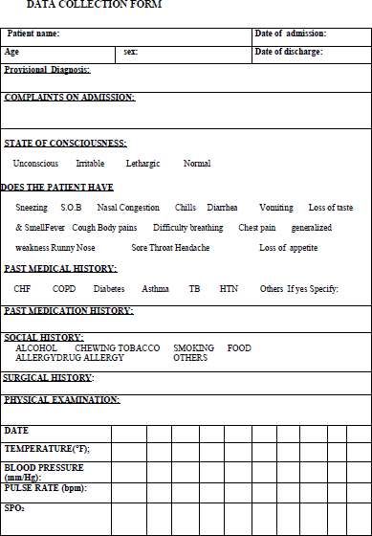
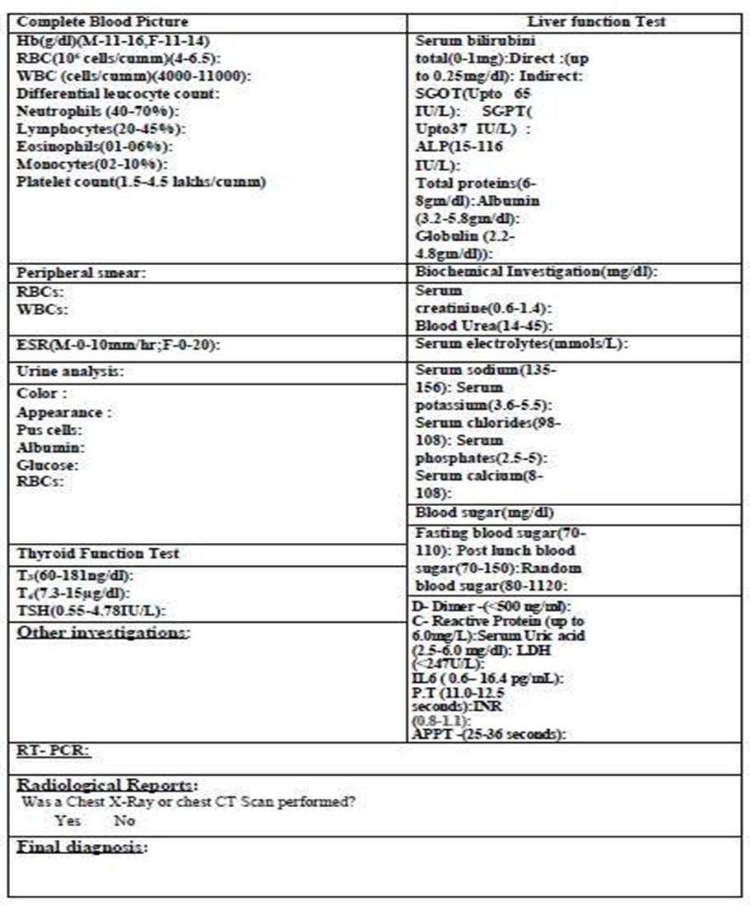

Slide 39
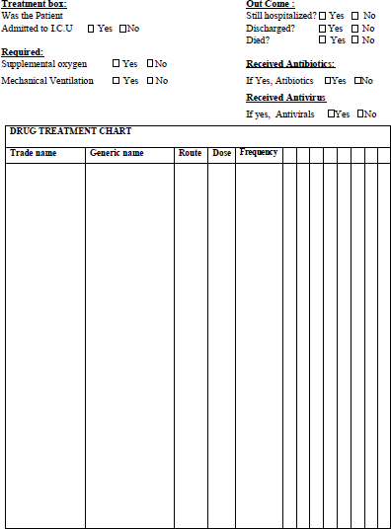
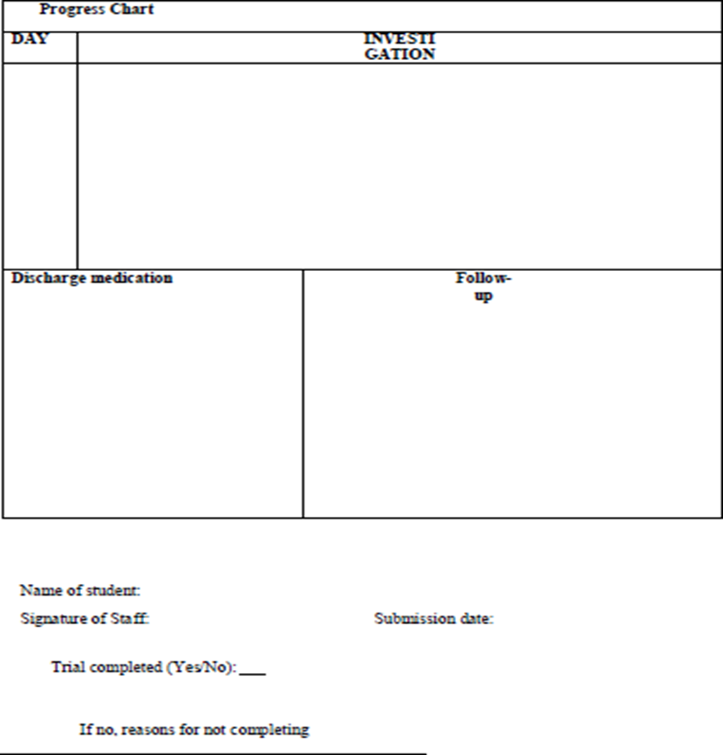

Slide 40
REFERENCES:
.
Eccles MP, Grimshaw JM, Johnston M, et al. "Applying psychological theories to evidence-based clinical practice: identifying factors predictive of managing upper respiratory tract infections without antibiotics". (2007). Implement Sci. 2: 26. doi:10.1186/1748-5908-2-26. PMC 2042498. PMID 17683558.
➢ Robert Beagle hole...; et al. The World Health Report 2004 - Changing History (PDF). World Health Organization. (2004) .pp. 120–4. ISBN 92-4-156265-X.
➢ Antibiotic Expert Group. Therapeutic guidelines: Antibiotic. 13th ed. North Melbourne: Therapeutic Guidelines; 2006.
➢ van Riel D, Munster VJ, de Wit E, et al. "H5N1 Virus Attachment to Lower Respiratory Tract". Science. (April 2006). 312 (5772): 399. doi:10.1126/science.1125548. PMID 16556800.
➢ Jump up to: a b c Doan, Quynh; Enarson, Paul; Kissoon, Niranjan; Klassen, Terry P.; Johnson, David W. "Rapid viral diagnosis for acute febrile respiratory illness in children in the Emergency Department". The Cochrane Database of Systematic Reviews (2014-09-15).
➢ "Breath Test Could Sniff Out Infections in Minutes". Scientific

Slide 41
Claire Hopkins, MikkelAlanin , Carl Philpott , Phil Harries , Katherine Whitcroft .Management of new onset loss of sense of smell during the COVID-19 pandemic - BRS Consensus Guidelines.epub 2020 sep 24:4-8
Tim Montrief 1, Mark Ramzy 2, Brit Long 3, Michael Gottlieb 4, Dan Hercz5 :COVID-19 respiratory support in the emergency department setting.study in Austria Published by Elsevier Inc. 2020 march(20): 57
Sanchit Kumar 1, Shubham Mehta 1, Nikhil Sarangdhar 2, Animesh Ray 1, Sanjeev Sinha 1, Naveet Wig : Management of COVID-19 from the pulmonologist's perspective. Study in India epub 2020 may (30):39
Vijay Kumar Jain , Karthikeyan P Iyengar , David AnanthSamy , Raju Vaishya.Tuberculosis in the era of COVID-19 in India.. Published by Elsevier .dec 2020..
Syed Muhammad Ali Shah , Tahir Rasheed , KomalRizwan , Muhammad Bilal , Hafiz M N Iqbal, Nasir Rasool , Sebastian Toma , Luigi Geo Marceanu , Elena Bobescu.Risk management strategies and therapeutic modalities to tackle COVID- 19/SARS-CoV-2.epub dec 29;5-9.
MoizBakhiet , Sebastien Taurin.SARS-CoV-2: Targeted managements and vaccine development.pubmed 2020 dec …..6-
10.study in ethopia…

